Slide 1
Write your first Flutter app Part 1 https://codelabs.developers.google.com/codelabs/first-flutter-app-pt1/
Notes:
I’d like to concentrate on two parts of Flutter, that I especially admire

Slide 2
What you’ll learn?
How to write a Flutter app that looks natural on iOS, Android, and the web
Basic structure of a Flutter app
Finding and using packages to extend functionality
Using hot reload for a quicker development cycle
How to implement a stateful widget
How to create an infinite, lazily loaded list
Notes:
The beauty of hot reload is, that even after fixing an error, state is still maintained - allowing to iterate and develop far quicker.

Slide 3
What you'll use?
You can run this codelab by using any of the following devices:
A physical device (Android or iOS) connected to your computer and set to developer mode
The iOS simulator (requires installing Xcode tools)
The Android emulator (requires setup in Android Studio)
A browser (Chrome is required for debugging)
Notes:
The beauty of hot reload is, that even after fixing an error, state is still maintained - allowing to iterate and develop far quicker.

Slide 4
Step 1: Create the starter Flutter app
Create a simple, templated Flutter app, using the instructions in Getting Started with your first Flutter app.
Name the project startup_namer (instead of flutter_app).
You’ll mostly edit lib/main.dart, where the Dart code lives.

Slide 5
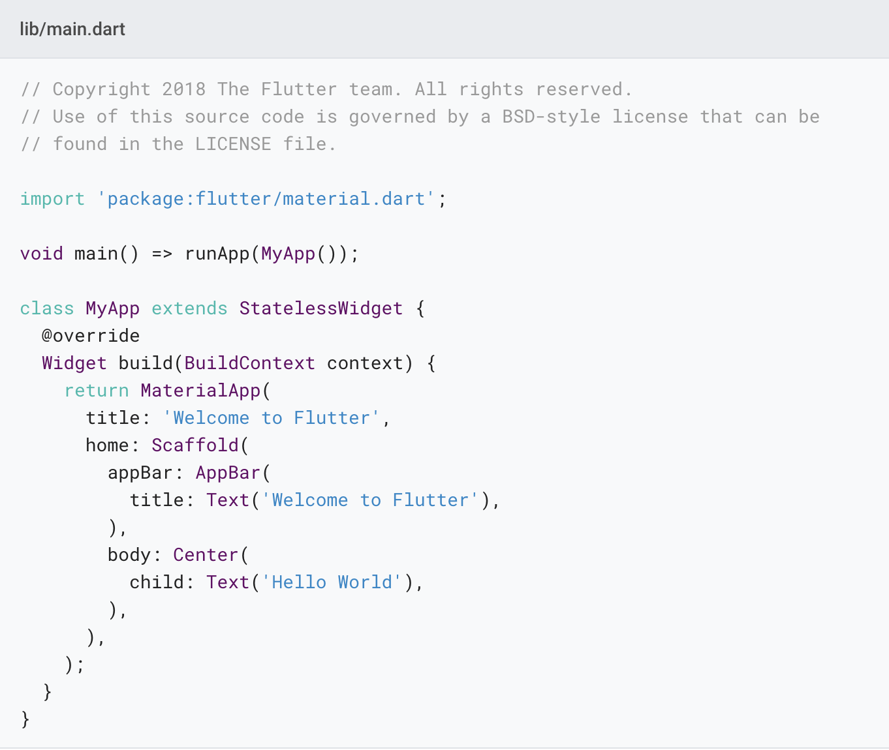
Replace the contents of lib/main.dart.
Delete all of the code from lib/main.dart. Replace with the following code, which displays “Hello World” in the center of the screen.

Slide 6
Run the app in the way your IDE describes. You should see either Android, iOS, or web output, depending on your device.

Slide 7
Observations
This example creates a Material app. Material is a visual design language that is standard on mobile and the web.
The main() method uses arrow (=>) notation. Use arrow notation for one-line functions or methods.
The app extends StatelessWidget which makes the app itself a widget. In Flutter, almost everything is a widget, including alignment, padding, and layout.

Slide 8
Observations
The Scaffold widget, from the Material library, provides a default app bar, title, and a body property that holds the widget tree for the home screen. The widget subtree can be quite complex.
A widget’s main job is to provide a build() method that describes how to display the widget in terms of other, lower level widgets.
The body for this example consists of a Center widget containing a Text child widget. The Center widget aligns its widget subtree to the center of the screen.

Slide 9
Step 2: Use an external package
In this step, you’ll start using an open-source package named english_words, which contains a few thousand of the most used English words plus some utility functions.
You can find the english_words package, as well as many other open source packages, on pub.dev.

Slide 10
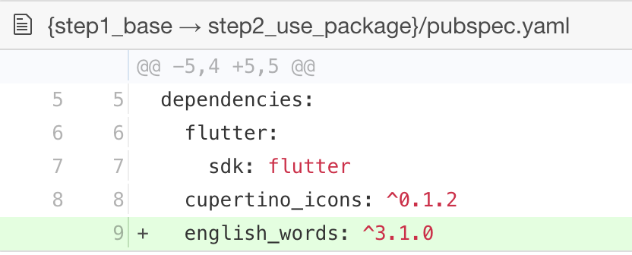
The pubspec.yaml file manages the assets and dependencies for a Flutter app. In pubspec.yaml, add english_words (3.1.5 or higher) to the dependencies list:

Slide 11
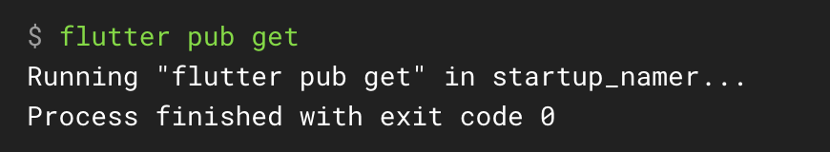
While viewing the pubspec.yaml file in Android Studio’s editor view, click Packages get. This pulls the package into your project. You should see the following in the console:

Slide 12
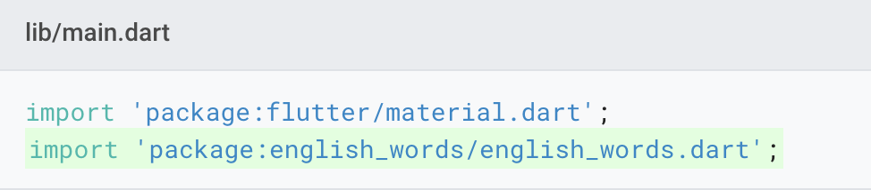
In lib/main.dart, import the new package:

Slide 13
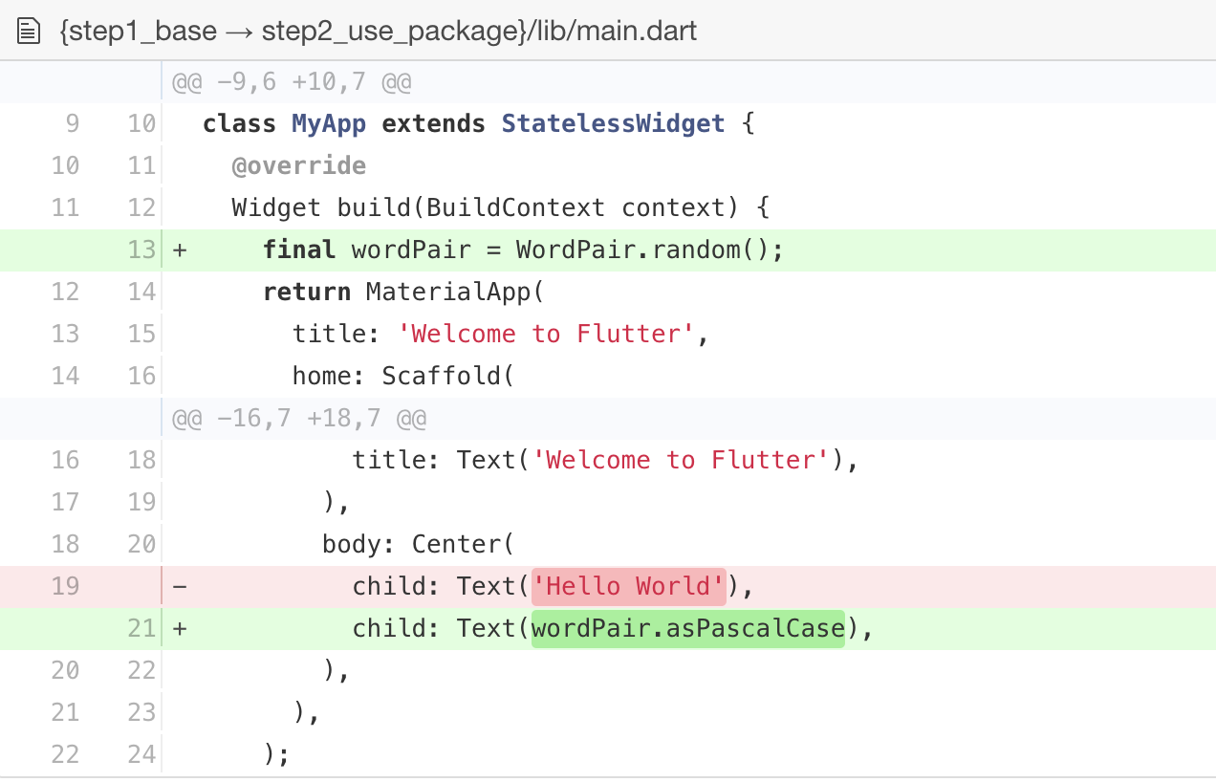
Use the English words package to generate the text instead of using the string “Hello World”:

Slide 14
If the app is running, hot reload to update the running app. Each time you click hot reload, or save the project, you should see a different word pair, chosen at random, in the running app.

Slide 15
Problems?
If your app is not running correctly, look for typos. If you want to try some of Flutter’s debugging tools, check out the DevTools suite of debugging and profiling tools. If needed, use the code at the following links to get back on track.
pubspec.yaml
lib/main.dart

Slide 16
Step 3: Add a Stateful widget
Stateless widgets are immutable, meaning that their properties can’t change—all values are final.
Stateful widgets maintain state that might change during the lifetime of the widget.
In this step, you’ll add a stateful widget, RandomWords, which creates its State class, _RandomWordsState. You’ll then use RandomWords as a child inside the existing MyApp stateless widget.

Slide 17
Implementing a stateful widget requires at least two classes:
a StatefulWidget class that creates an instance of
a State class.
The StatefulWidget class is, itself, immutable, but the State class persists over the lifetime of the widget.

Slide 18
Create the boilerplate code for a stateful widget.
In lib/main.dart, position your cursor after all of the code, enter Return a couple times to start on a fresh line.
In your IDE, start typing stful. The editor asks if you want to create a Stateful widget.
Press Return to accept. The boilerplate code for two classes appears, and the cursor is positioned for you to enter the name of your stateful widget.

Slide 19
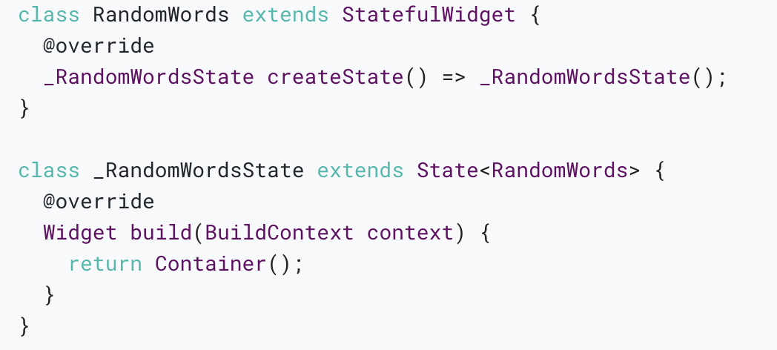
Enter RandomWords as the name of your widget.
The RandomWords widget does little else beside creating its State class.
Both classes now look as follows:

Slide 20
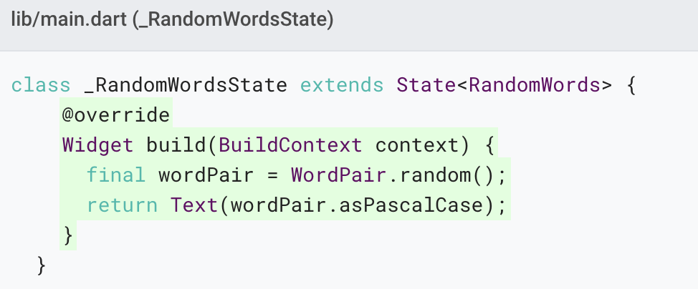
Update the build() method in _RandomWordsState:

Slide 21
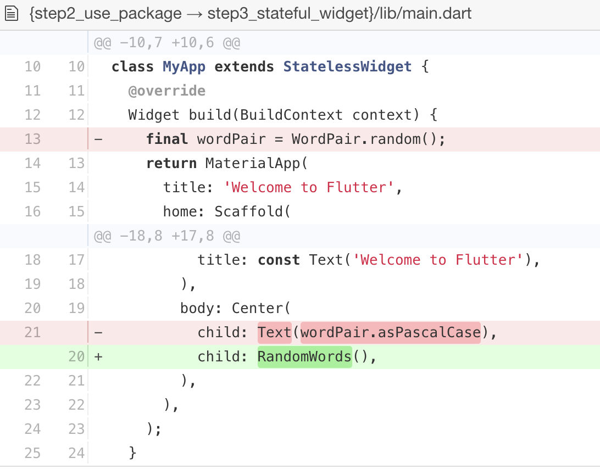
Remove the word generation code from MyApp by making the changes shown in the following diff:

Slide 22
Restart the app. The app should behave as before, displaying a word pairing each time you hot reload or save the app.

Slide 23
Problems?
If your app is not running correctly, look for typos. If you want to try some of Flutter’s debugging tools, check out the DevTools suite of debugging and profiling tools. If needed, use the code at the following link to get back on track.
lib/main.dart

Slide 24
Step 4: Create an infinite scrolling ListView
In this step, you’ll expand _RandomWordsState to generate and display a list of word pairings.
As the user scrolls the list (displayed in a ListView widget) grows infinitely. ListView’s builder factory constructor allows you to build a list view lazily, on demand.

Slide 25
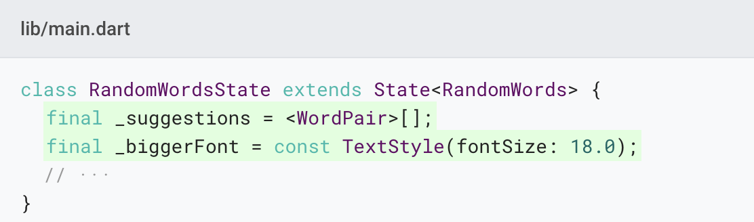
Add a _suggestions list to the _RandomWordsState class for saving suggested word pairings. Also, add a _biggerFont variable for making the font size larger.

Slide 26
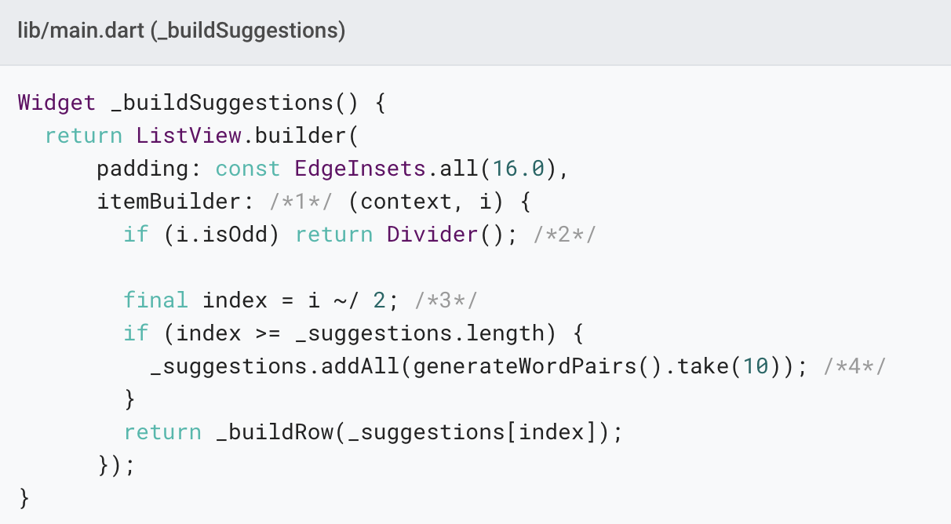
Add a _buildSuggestions() function to the _RandomWordsState class:

Slide 27
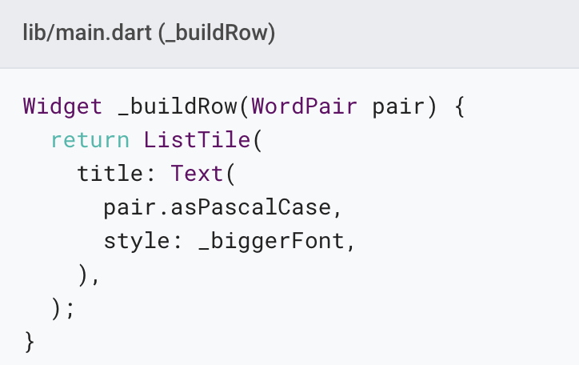
Add a _buildRow() function to _RandomWordsState:

Slide 28
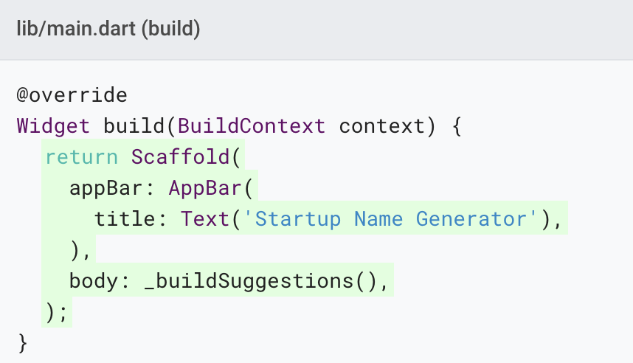
In the _RandomWordsState class, update the build() method to use _buildSuggestions(), rather than directly calling the word generation library. Replace the method body with the highlighted code:

Slide 29
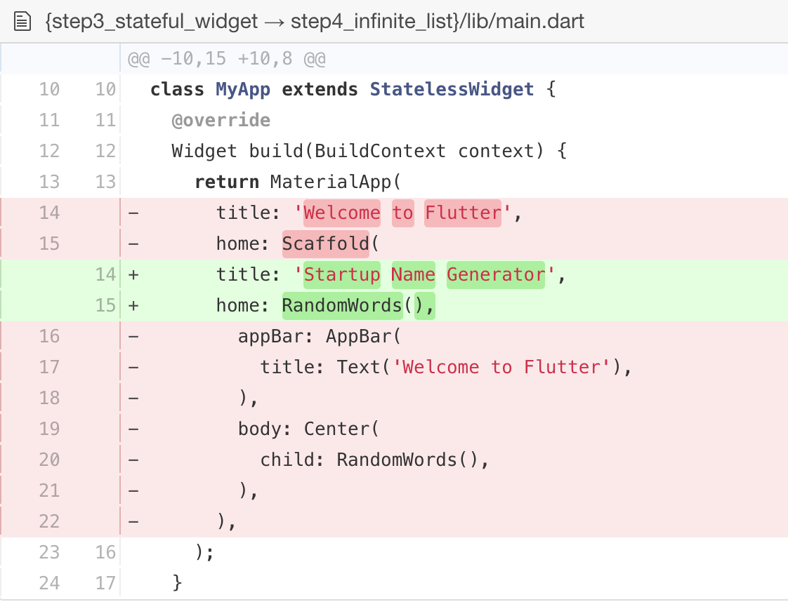
In the MyApp class, update the build() method by changing the title, and changing the home to be a RandomWords widget:

Slide 30
Restart the app. You should see a list of word pairings no matter how far you scroll.

Slide 31
Problems?
If your app is not running correctly, look for typos. If you want to try some of Flutter’s debugging tools, check out the DevTools suite of debugging and profiling tools. If needed, use the code at the following link to get back on track.
lib/main.dart

Slide 32
Profile or release runs
So far you’ve been running your app in debug mode. Debug mode trades performance for useful developer features such as hot reload and step debugging.
Once you are ready to analyze performance or release your app, you’ll want to use Flutter’s “profile” or “release” build modes.
For more details, see Flutter’s build modes.

Slide 33
Next steps
Congratulations! You’ve written an interactive Flutter app that runs on both iOS and Android. In this codelab, you’ve:
Created a Flutter app from the ground up.
Written Dart code.
Leveraged an external, third-party library.
Used hot reload for a faster development cycle.
Implemented a stateful widget.
Created a lazily loaded, infinite scrolling list.

Slide 34
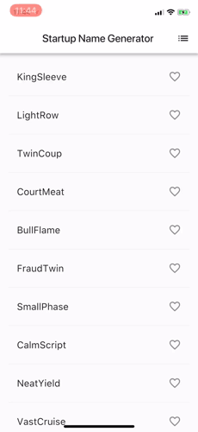
If you would like to extend this app, proceed to part 2 on the Google Developers Codelabs site, where you add the following functionality:
Implement interactivity by adding a clickable heart icon to save favorite pairings.
Implement navigation to a new route by adding a new screen containing the saved favorites.
Modify the theme color, making an all-white app.

Slide 35
Thank you!
Wenxuan Shi
College of Software, Nankai University
Email: shiwx@nankai.edu.cn
Wechat: 13920561100

